Slide 1

UE20CS390A – Capstone Project Phase – 1
SEMESTER - VI
END SEMESTER ASSESSMENT
Project Title : An Entity to 3D model Prototyping from a Photo
Project ID : PW23_NVP_02
Project Guide : Prof. Nitin V Pujari
Project Team : Nikita S Patgar [PES1UG21CS825]
Ravallu Nikhil Rajareddy [PES1UG21C830]
Titeersha Ghatak Chowdhury [PES1UG21CS834]
Vaishnavi .K [PES1UG21CS838]

Slide 2
Outline
An Entity to a 3d model Prototyping from a Photo
Problem Statement
Abstract and Scope
Literature Survey
Suggestions from Review – 3
Design Approach
Design Constraints, Assumptions & Dependencies
Proposed Methodology / Approach
Architecture
Design Description
Technologies Used
Project Progress
References

Slide 3
Abstract and Scope
An Entity to a 3d model Prototyping from a Photo
Using a variety of methods and tools, it is possible to build a digital representation of an object that closely mimics its physical counterpart when creating a 3D model prototype from a photograph.
Numerous fields, such as product design, architectural visualisation, and game development, can benefit from the use of this method.
The selection of the proper hardware and software tools, as well as the execution of the modelling process itself, are all included in the scope of this procedure.

Slide 4
Scope
An Entity to a 3d model Prototyping from a Photo
The scope of the project includes several components:
The first component involves collecting photos of , which can be done by some set of photos taking photos or using existing photos.
The second component involves preprocessing the photos.
The third component involves feature extraction, which is the process of analyzing the photos and extracting key features that can be used to generate gcode.

Slide 5
Scope
An Entity to a 3d model Prototyping from a Photo
IV. The fourth component involves generating gcode from the extracted features, which is the set of instructions that tells the 3D printer how to create the 3D printed model.
This may involve using a tool or library that converts the features into gcode that can be read by a 3D printer.
V. The fifth component involves 3D printing the model using the generated g-code. This may involve using a 3D printer and the appropriate printing material.

Slide 6
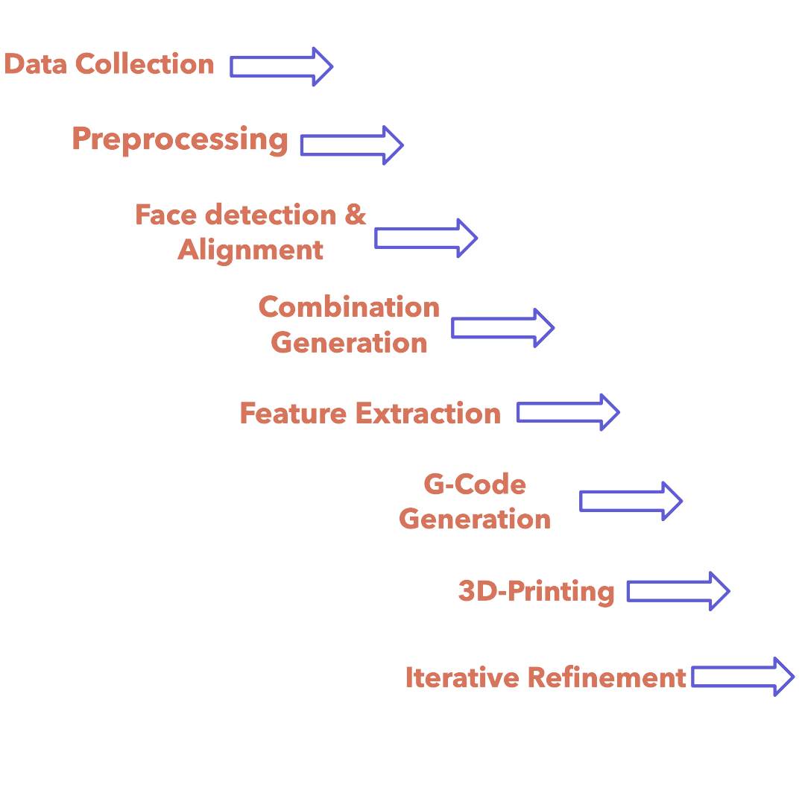
Design Approach
An Entity to a 3d model Prototyping from a Photo

Slide 7
Problem Statement
An Entity to a 3d model Prototyping from a Photo
Design a system that takes photos of human faces, extracts features, and generates gcode for 3D printing. The goal is to create 3D printed models that combine different combinations of people's faces. The system should allow users to collect photos, extract features, generate gcode, and interface with a 3D printer. The resulting 3D printed models should accurately represent the desired face combinations with high quality and detail.

Slide 8
Literature Survey
An Entity to a 3d model Prototyping from a Photo
YEAR | AUTHOR | OBJECTIVE | DATA | METHODOLOGY | CONCLUSION
2021 | Pankaj Kumar | In this paper, CLAHE, HOG features and SVM classifier based face recognition algorithm is introduced. This proposed algorithm is compared with HOG features and SVM classifier based face recognition algorithm. | Face Detection and Recognition Using Machine Learning | Haar Cascade, CNN | Results show that the proposed algorithm is having an improved face-recognition performance. It gives more accuracy and productiveness.
2020 | Gurlove Singh; Amit Kumar Goel | The area of concern of this paper is using the digital image processing to develop a face recognition system | Face Detection and Recognition System Using Digital Image Processing | Haar Cascade, LBP | The paper proposes a face detection and recognition system using digital image processing techniques. The proposed system is efficient in detecting and recognizing faces.

Slide 9
Literature Survey
An Entity to a 3d model Prototyping from a Photo
YEAR | AUTHOR | COUNTRY | OBJECTIVE | DATA | METHODOLOGY | CONCLUSION
2010 | Yue Ming Qiuqi Ruan Xiaoli Li | China | In this paper, a novel framework for 3D face reconstruction from a single 2D face image was proposed. We focus on generating 3D face model without expensive devices and complicated calculation | 2d facial image | 1.Illumination Compensation 2.Face Detection 3.Feature Points Detection | The authors evaluate their method on several real-world photos of plants and landscapes. They compare their method to other 3D modeling techniques, such as photogrammetry and laser scanning.
2006 | Fabio Remondino,Sabry El-Hakim | Canada | The primary issues and potential solutions for the creation of 3D models from terrestrial photographs are discussed in this research, | IMAGE-BASED 3D MODELLING | 1.IBR, or image-based rendering 2.Modelling with images (IBM). 3.Range-based modelling. 4.Combination of image- and range-based modelling. | Many of the problems of converting a measured point cloud into a realistic 3D polygonal model that can satisfy high modelling and visualisation demands have not been completely solved.

Slide 10
Literature Survey
An Entity to a 3d model Prototyping from a Photo
YEAR | AUTHOR | OBJECTIVE | DATA | METHODOLOGY | CONCLUSION
2018 | KH Teoh, RC Ismail SZM Naziri | This paper describes the concept on how to design and develop a face recognition system through deep learning using CNN and Computer vision like OpenCV | Face Recognition and Identification using Deep Learning Approach | 1.using CNN to build a Deep learning based model 2. computer Vision to train the data & act on the recognition process 3.Haar Cascade | In this paper, a face recognition & identification system is designed with the accuracy of 91.7% in recognising image and 86.7% in real-time video
2020 | Saurabh Kumar Singh Shrey Tanna | Object Reconstruction is the task of predicting the 3D model of an object given a set of 2D images. In this paper, we propose an approach to solving this problem, given a single 2D image. We attempt to make use of several deep learning techniques. | A Generative Modelling Technique for 3D Reconstruction from a Single 2D Image | 1.Neural Network Based 3D Reconstruction using 3D Recurrent Reconstruction Neural Network (3D-R2N2) 2.uses recurrent neural networks like LSTMs and GRUs, and convolutional neural networks as well | In this paper, we present an approach that simplifies the problem of reconstructing a 3D object from a single image using 3D-R2N2 and GAN, short for Generative Adversarial Networks for 3D generation

Slide 11
Literature Survey
An Entity to a 3d model Prototyping from a Photo
YEAR | AUTHOR | COUNTRY | OBJECTIVE | DATA | METHODOLOGY | CONCLUSION
2019 | Shyh-Kuang Ueng, Hsuan-Kai Huang, Zen-Yu Liu | Japan | This article proposes an innovative procedure to convert voxel-based models into G-codes for Additive Manufacturing (AM). The proposed procedure divides the foreground voxels into skin and internal regions at the preprocessing step. | Image-based Contouring and G-code Generation for Additive Manufacturing | 1.Contour generation for cluster. 2.Internal Region Hatching 3.Toolpath and g-code generation | In the proposed G-code generator, the input voxel-based model and the individual layers of the model are treated as3D and 2D images. Thus, the 3D skin regions and the 2D contours can be generated by using erosions and related image processing techniques.
2020 | Hsin-Cheng Huang | Japan | In layered manufacturing (LM), slicers are employed to convert input geometric models into G-codes. Conventional slicers accept only surface models as input data. | A G-Code Generator for Volumetric Models | 1.support structure generation 2.skin separation and slice generation | In this article, we proposed a slicer to transform voxel-based geometric models into G-codes.

Slide 12
Design Constraints, Assumptions & Dependencies
An Entity to a 3d model Prototyping from a Photo
Design Constraints:-
1.The resulting output may not be accurate.
Assumptions to be made are :-
User will be uploading the photo which contains atleast one human face.
The resolution of the photo is crucial in ensuring the accuracy of the model.

Slide 13
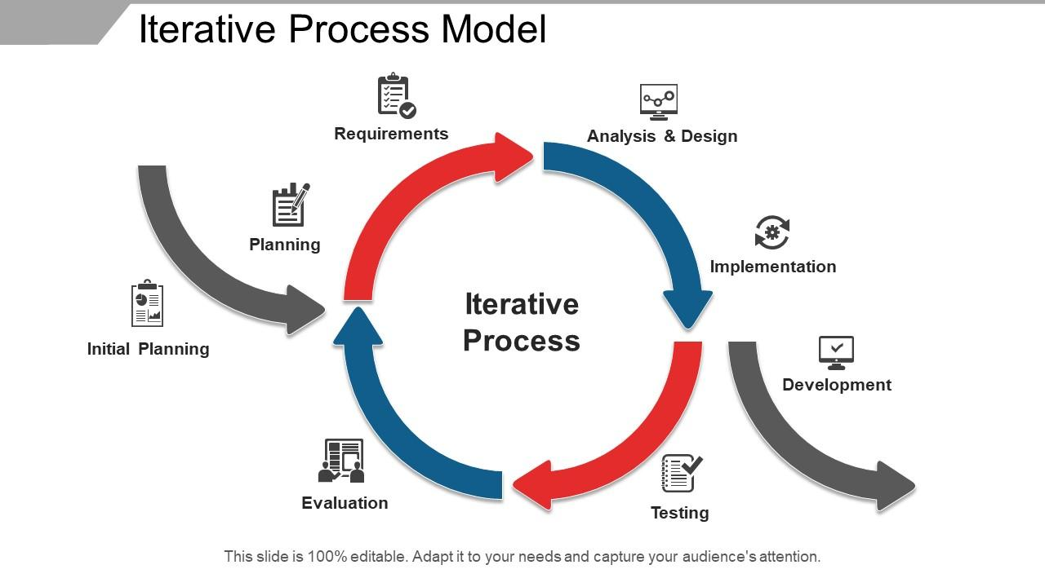
Proposed Methodology / Approach
An Entity to a 3d model Prototyping from a Photo
Iterative Model

Slide 14
Proposed Methodology / Approach
An Entity to a 3d model Prototyping from a Photo
Benefits of this approach :
Progress can be measured.
Some working functionality can be developed quickly and early in the life cycle.
Less costly to change the scope/requirements.
Easier to manage risk

Slide 15
Proposed Methodology / Approach
An Entity to a 3d model Prototyping from a Photo
Drawbacks of this approach
Management complexity is more.
Not suitable for smaller projects.

Slide 16
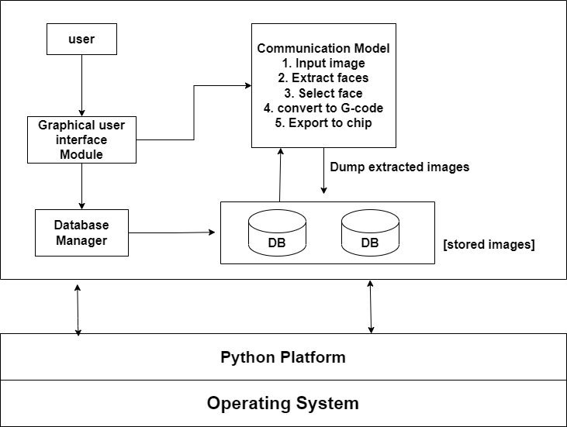
Architecture
An Entity to a 3d model Prototyping from a Photo
High Level Design(HLD) -

Slide 17
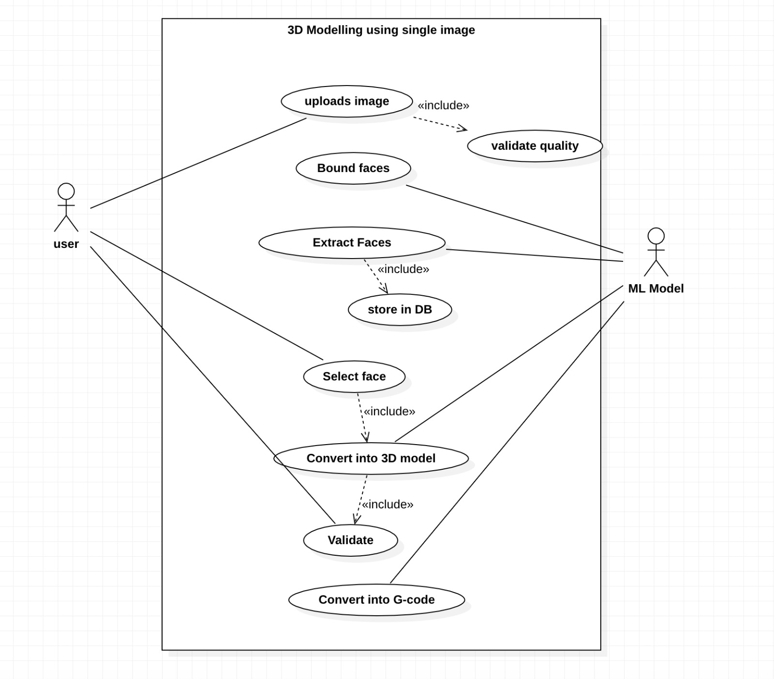
Design Description
An Entity to a 3d model Prototyping from a Photo
Use Case Diagram -

Slide 18
Design Description
An Entity to a 3d model Prototyping from a Photo
External Interfaces -
-> User Interface
-> Hardware requirements
-> Software requirements

Slide 19
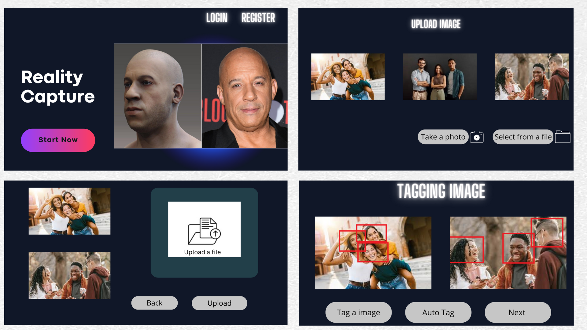
Design Description
An Entity to a 3d model Prototyping from a Photo
External Interfaces -
User Interface -

Slide 20
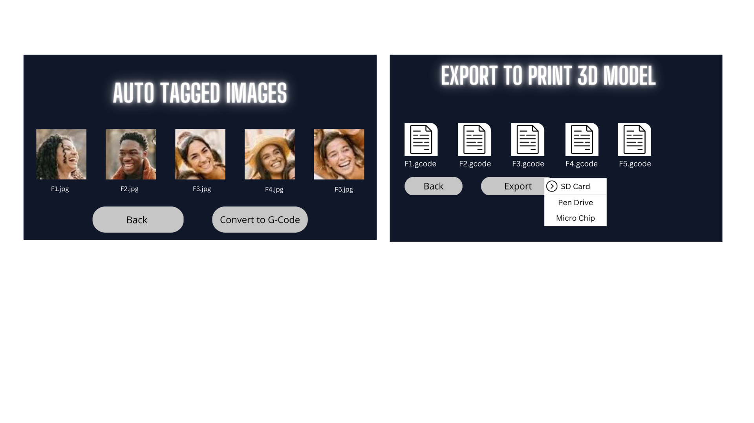
Design Description
An Entity to a 3d model Prototyping from a Photo
External Interfaces -
User Interface -

Slide 21
Design Description
An Entity to a 3d model Prototyping from a Photo
External Interfaces -
Hardware and Software Requirements -
Hardware requirements:
Computer
Camera
Graphic Card
Software requirements:
Compatible OS
Python Compiler
Required libraries

Slide 22
Technologies Used
An Entity to a 3d model Prototyping from a Photo
TensorFlow, PyTorch, and Keras - are useful for building the AI/ML model.
Scikit-image, OpenCV - provides a collection of algorithms for image processing, including segmentation and feature extraction.
Convolutional Neural Networks (CNNs) - are effective for image recognition and feature extraction
Generative Adversarial Networks (GANs) - can be used to generate 3D models based on the 2D images.
Blender, Autodesk Fusion 360 - Software used to convert the generated 3D models into printable g-code.

Slide 23
Project Progress
An Entity to a 3d model Prototyping from a Photo
Our team is presently engaged in the task of bounding of Faces from the input image. As per our current assessment, we have accomplished approximately 20% to 25% of the project's overall scope. We are constantly monitoring the progress and implementing requisite modifications to ensure that we achieve the project's objectives within the designated timeframe

Slide 24
Project Demo
An Entity to a 3d model Prototyping from a Photo
High-level algorithm for extracting and bounding faces from an image and creating a database:
1. Load the input image.
2. Convert the image to grayscale for better contrast and easier processing.
3. Detect faces in the image using a face detection algorithm, such as Haar cascades, which can be implemented using OpenCV or other computer vision libraries.
4. For each detected face, create a bounding box around it to localize the face in the image.
5. Crop the image using each bounding box to extract the face as a separate image.

Slide 25
Project Demo
An Entity to a 3d model Prototyping from a Photo
6. Save each face image to a separate file in a database/folder.
7. Generate 2^n combinations of face images by selecting all possible combinations of n faces from the database/folder.
8. Store each combination as a separate file in a database/folder.
9. Allow users to upload images by providing a file upload feature or allowing them to enter the image name manually.
10. Repeat steps 1-8 for each uploaded image.

Slide 26
Summary of work done in Capstone Phase-1
An Entity to a 3d model Prototyping from a Photo
Phase 1 of the project has been focused on gathering relevant research papers and data to kick-start the project, dedicated to laying the groundwork for creating an AI/ML-based model capable of generating 3D models from single input images. The team has conducted a comprehensive review of relevant research papers in the field and gathered a substantial dataset of images to train and test the model.
Moreover, the team has begun working on the initial preprocessing of the images involves cleaning, transforming, and normalizing it to prepare it for analysis and modeling.

Slide 27
Project Plan for Capstone Phase-2
An Entity to a 3d model Prototyping from a Photo
As we move into Phase 2 of the project, the team plans to complete working on the preprocessing of the input images and to focus on developing and testing different models using the dataset that has been collected in Phase 1. The goal is to optimize their performance, including factors such as accuracy, speed, in order to produce high-quality 3D models that are faithful to the input images.

Slide 28
References
An Entity to a 3d model Prototyping from a Photo
[1] Nath, Raktim & Kakoty, Kaberi & Bora, Dibya & Welipitiya, Udari. (2021). Face Detection and Recognition Using Machine Learning. 43. 194-197.
[2]G. Singh and A. K. Goel, "Face Detection and Recognition System using Digital Image Processing," 2020 2nd International Conference on Innovative Mechanisms for Industry Applications (ICIMIA), Bangalore, India, 2020, pp. 348-352, doi: 10.1109/ICIMIA48430.2020.9074838.
[3] KH Teoh et al 2021 J. Phys.: Conf. Ser. 1755 012006

Slide 29
References
An Entity to a 3d model Prototyping from a Photo
[4] Harušinec, Jozef & Suchánek, Andrej & Loulová, Mária. (2019). Creation of prototype 3D models using RAPID PROTOTYPING. MATEC Web of Conferences. 254. 01013. 10.1051/matecconf/201925401013.
[5] Ueng, Shyh-Kuang & Huang, Hsuan-Kai & Liu, Zen-Yu. (2019). Image-based Contouring and G-code Generation for Additive Manufacturing.
[6] Ueng, Shyh-Kuang & Huang, Hsuan-Kai & Huang, Hsin-Cheng. (2019). A G-Code Generator for Volumetric Models. Applied Sciences. 9. 3868. 10.3390/app9183868.

Slide 30
An Entity to a 3d model Prototyping from a Photo
Thank You

